Slide 1
Pointer Swizzling and Object Migration

Slide 2
Pointer Swizzling
A simple concept of using pointers for addressing instead of going through translation table for all queries.
The database addresses in data blocks/records are replaced by the corresponding virtual memory addresses when the referenced data block/record resides in memory

Slide 3
In object systems, one can navigate from one object to another using path expressions that involve attributes with object-based values.
For example, if object c is of type Car, then c.engine.manufacturer.name is a path expression.
These are basically pointers. Usually on disk, object identifiers are used to represent these pointers.
However, in memory, it is desirable to use in-memory pointers for navigating from one object to another.

Slide 4
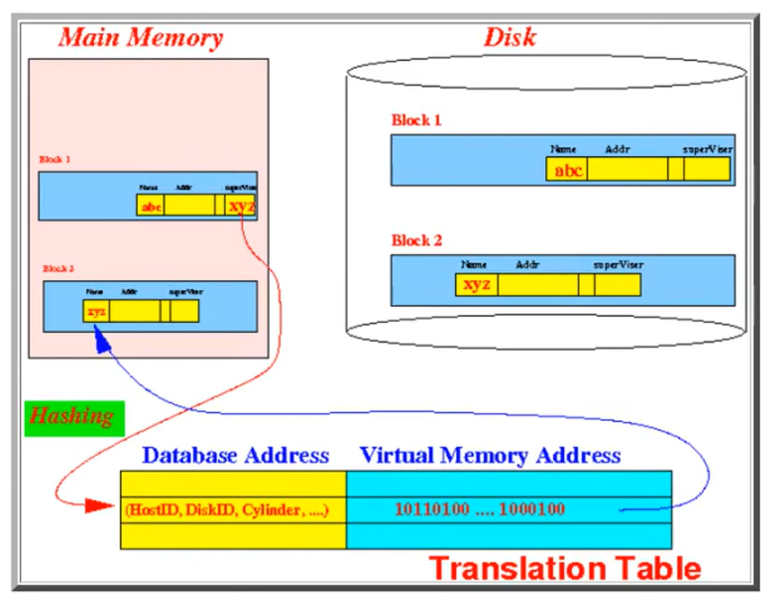
Inefficiency in accessing a block/record that is stored in memory using the translation table:
We must translate the database address each time we want to access a block stored in memory

Slide 5
Methods of swizzling
Swizzling in the general case can be complicated.
The reference graph of pointers might contain an arbitrary number of cycles; this complicates maintaining a mapping from the old unswizzled values to the new addresses.
Associative arrays are useful for maintaining the mapping, while algorithms such as breadth-first search help to traverse the graph, although both of these require extra storage.
The different types of swizzling are:
Automatic swizzling
On-demand swizzling

Slide 6
Methods of unswizzling
The offset of the pointed-to object in the file
The index of the pointed-to object in some sequence of records
A unique identifier possessed by the pointed-to object, such as a person's Social Security number.

Slide 7
The process of converting a disk version of the pointer to an in-memory version of a pointer is known as "pointer-swizzling". Two types of pointer swizzling mechanisms are:
Hardware-Based:- The operating system's page-fault mechanism is used; when a page is brought into memory, all the pointers in it are swizzled, and they point to reserved virtual memory frames.
Software Based:- An object table is used for pointer- swizzling purposes so that a pointer is swizzled to point to a location in the object table - that is LOIDs are used.

Slide 8
Pointer swizzling: security weaknesses
An attacker's presentation of a specially crafted file may allow access to addresses outside of the expected and proper bounds.
In systems with weak memory protection this can lead to exposure of confidential data or modification of code likely to be executed.
If the system does not implement guards against execution of data the system may be severely compromised by the installation of various kinds of malware.

Slide 9
OBJECT MIGRATION
Object Migration is the process to migrate or move objects from one environment to another environment.
Object migration lets you copy resources from one portal to another.
To support this migration process, the two databases need to use the same table structure
You can copy resources from one portal to another by creating migration packages, which can be used to:
Export objects created in a development portal and import them to your production portal when they have been properly tested.
Import portal objects in order to install new features on your portal. For example, you might want to install a portlet suite and register those portlets in your portal.

Slide 10
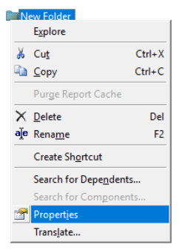
OBJECT PROPERTIES
Reviewing and Managing Properties of MicroStrategy Objects may be a task for Developers and Architects when building and Application, but it is one of the main responsibilities of a Platform Administrator when synchronizing objects across environments.
It is important to have good understanding of Object Properties, before attempting to manage Object Migrations:

Slide 11
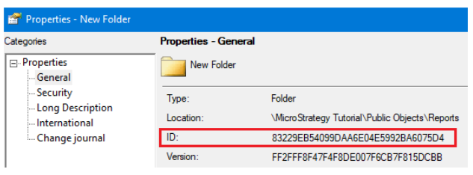
OBJECT IDENTIFICATION
Objects in MicroStrategy get referenced by their GUID (Globally Unique Identified).
This helps to maintain dependencies while object definition, naming or other properties get modified.
If two objects have the same GUID, they refer to the same object. When synchronizing an application between environments, the complete set of objects being a part of that application need to be updated accordingly.
Objects in MicroStrategy will also have a Version ID which changes every time the object is modified.

Slide 12
ACCESS CONTROL LIST
MicroStrategy Objects get assigned Permissions in conjunction with Users or User Groups, just like objects in an Operating Systems (“Security” in Windows or “row” in Unix and Linux systems).
MicroStrategy Objects will inherit their Access Control Lists from the Folder they are created in.
When object is moved to another folder, it will maintain their ACL, however, when the object is copied, the ACL will be assigned from the target folder, just like when creating the new object.
Developers and Architects must be aware of those settings to successfully build applications as a team.
In some cases, Platform Administrator might be asked to help with modifying the Access Control List, as his/hers credentials allows to bypass the ACL settings.

Slide 13
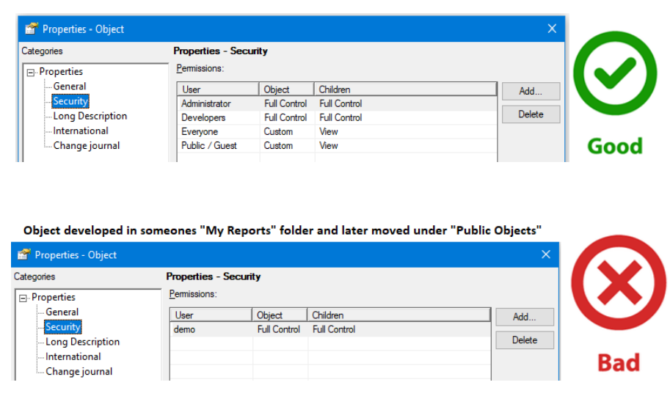
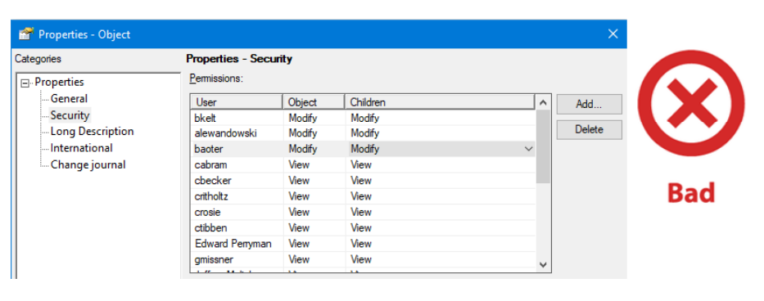

Slide 14
The variable migration analysis process performs the following steps:
Scans source database for variables and displays them in a folder tree
Allows the selection of variables for comparison
Compares the selected variables against variables in a target database
Determines the list of all calculations referenced by the selected variables
Checks and displays if
The two databases have the same database version
The source and target databases are different
The source format tables exist in the target database
The source format table fields exist in the target database format table
The login user is an administrative user
Displays a summary report containing:
Variables that exist only in the source database, which would need to be added to the target
Target variables that are exactly the same as the source database and therefore would not need to be migrated
Target variables that are different than in the source database, which would need to be replaced in the target

Slide 15
Migration Feature
Portal objects that can be included in the package
Collaboration and Publisher information
Requests and approval
Creating a migration package
Object dependencies
Unique universal identifiers (UUIDs) and their effect on subsequent importing migration packages

